Slide 1
Data Analysis Project 1.
Predicting Stock Returns Using Machine Learning
Nov 4, 2024
Group Members: Kai Ren, WeiJie Zhang, Yang Lan, YiMing Jiang, Rui Hu

Slide 2
Data Analysis Project 1 Framework
Component Stocks of CSI500
Collecting Dataset
Factor Engineering
Training Model
Backtesting
Daily & Min Trading
Data
Fundamental
Data
Macro
Data
Factors Importances Analysis
Daily Trading
Factors
Fundamental
Factors
Macro
Factors
Return
Labels
Factors Importance
Select & Normalize
Machine Learning Models 🔥
Adjustance for
Less Overfitting
MLP
LSTM
···
Conv
Trained Models ❄️
Future Return
Prediction
Market Actions
Backtesting
MLP
LSTM
···
Conv
Fig 1. The Framework of Data Analysis Project 1.

Slide 3
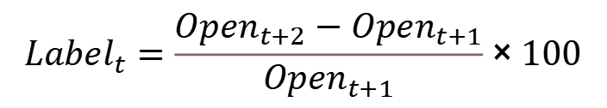
1. Data Collection
Research object: CSI 500 (constituent stocks on September 30, 2024)
Time interval: January 1st, 2019 – June 30th, 2024 (5.5 years with 1312 trading days)
Highest number of trading days: 1312 days, CHINA BAOAN GROUP CO., LTD (000009.sz)
Lowest number of trading days: 277days, KEDA Industrial Group (600499.sh)
Label：
$$Label_{t}=\frac{Open_{t+2}−Open_{t+1}}{Open_{t+1}}×100$$
Daily Trading Data
High-frequency Data
Macro & Fundamental Data
Open
Close
High
Low
Volume
Amount
Amplitude
RF_Rate
RF_Amt
Turnover
Vwap
Open
Close
High
Low
Volume
Amount
Back_adj
Turnover_float
Monthly Overview Documents of Shanghai Stock Exchange and Shenzhen Stock Exchange
Data from the National Bureau of Statistics
Data of China's treasury bond bond yield
Balance sheet
Cash Flow Statement
Income Statement
Relative Value Index
Notes:
把 Label 写在 Daily Trading Data 里面

Slide 4
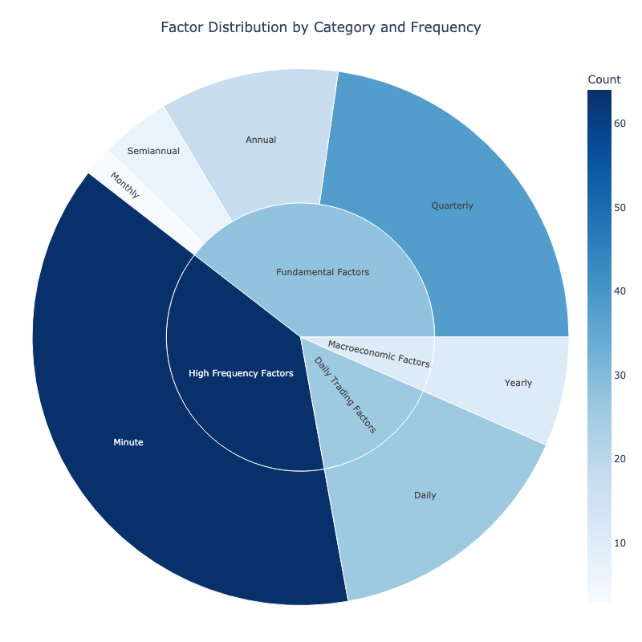
2. Factor Engineering
Factor Overview —— Total: 167 Original Factors
Daily Trading Factors (26)
Capture essential market dynamics at a daily frequency and serve as the core building blocks.
High Frequency Factors (64)
Identify short-term price movements, volatility, and liquidity, which are crucial for predicting price in the short run.
Fundamental Factors (66)
Derived from company financials, representing various aspects of a firm’s profitability, growth, leverage, and operational efficiency.
Macroeconomic Factors (11)
Provide context on liquidity, economic growth, inflation, and monetary policy trends, which are crucial drivers of stock performance over longer horizons.
Fig 2. Factor Distribution by Category and Frequency

Slide 5

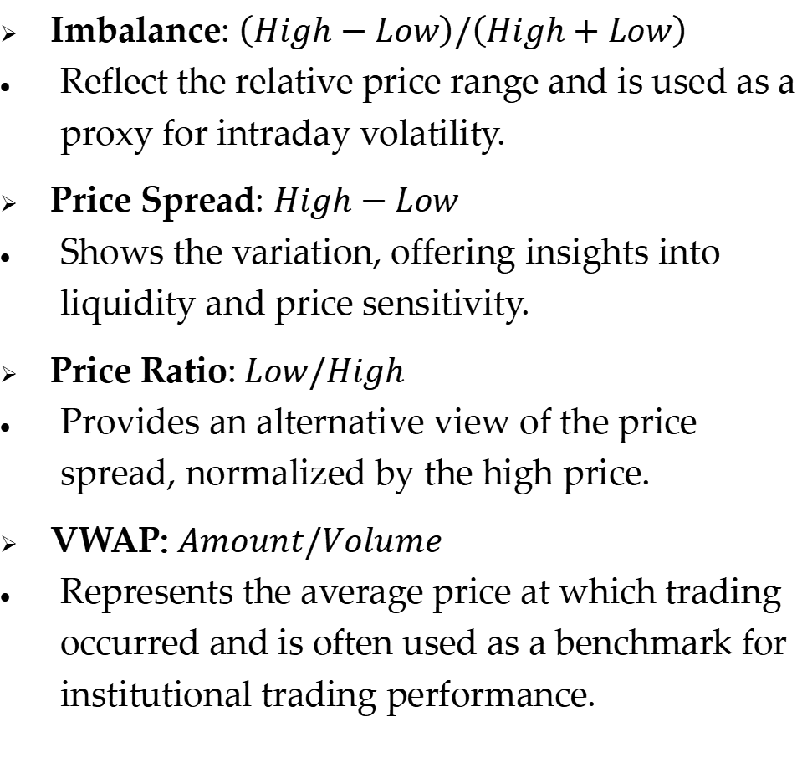
2.1 High Frequency Factors (64)
5-Minute Trading Data
Collecting Dataset
Imbalance: $\left(High−Low\right)/\left(High+Low\right)$
Reflect the relative price range and is used as a proxy for intraday volatility.
Price Spread: $High−Low$
Shows the variation, offering insights into liquidity and price sensitivity.
Price Ratio:$Low/High$
Provides an alternative view of the price spread, normalized by the high price.
VWAP: $Amount/Volume$
Represents the average price at which trading occurred and is often used as a benchmark for institutional trading performance.
Imbalance
Price Spread
Price Ratio
VWAP
Construct Basic Factor
Operators
Skewness
Std
Kurtosis
Lagged 1 Autocorrelation
Batch Processing by Operators
64 High Frequency Factors
Fig 3. Pipeline for Constructing High Frequency Factors
Notes:
一些细节还可以扣一下：
这一页的 Subtitle 写成 2.1
刚开始是倒三角的 bullet，洗面详细描述的时候才是点
图有点不好看，比如 Operations 完全可以不加阴影，另外最后一个饼和上面的间距太大了

Slide 6
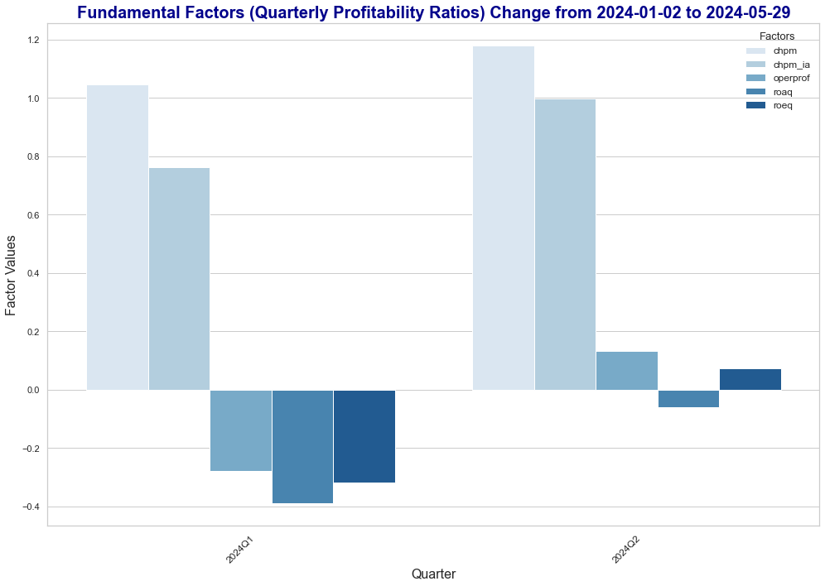
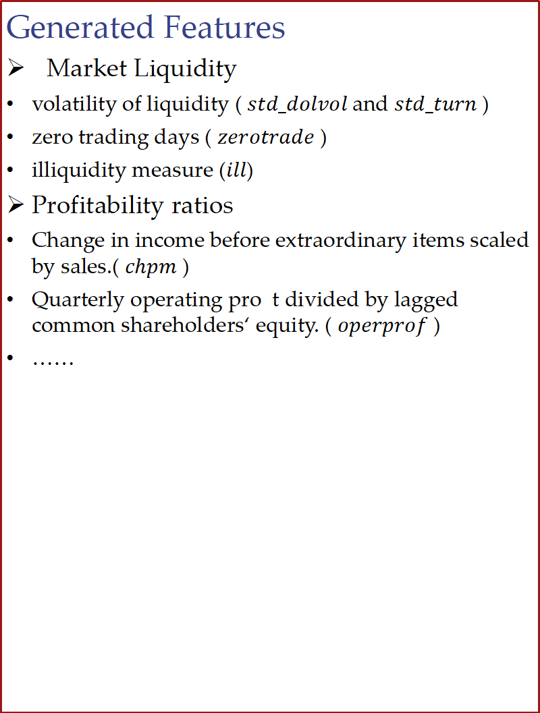
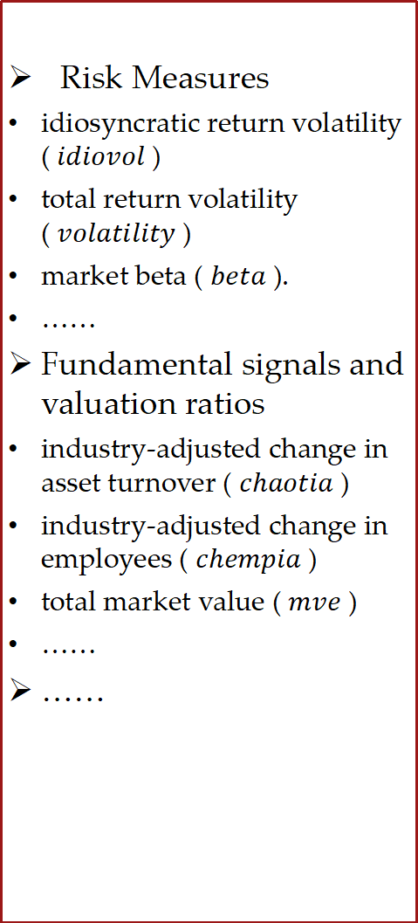
2.2 Fundamental Factors (66)
Generated Features
Market Liquidity
volatility of liquidity ( $std_dolvol$and $std_turn$)
zero trading days ( $zerotrade$ )
illiquidity measure ($ill$)
Profitability ratios
Change in income before extraordinary items scaled by sales.( $chpm$ )
Quarterly operating pro t divided by lagged common shareholders‘ equity. ( $operprof$ )
……
Risk Measures
idiosyncratic return volatility ( $idiovol$ )
total return volatility ( $volatility$ )
market beta ( $beta$ ).
……
Fundamental signals and valuation ratios
industry-adjusted change in asset turnover ( $chaotia$ )
industry-adjusted change in employees ( $chempia$ )
total market value ( $mve$ )
……
……
Source Data
Current Asset
Current Liabilities
Cash
Market Capitalization
Depreciation
P/E Ratio
Debt Ratio
Largest Holder Rate
……
Notes:
还是有一些细节，尽量调整好：
左边框省略号就在外头
这一页的副标题，直接可以是 Fundamental Factors
还有点的方法，全部用斜三角即可，不要一会斜三角，一会方框

Slide 7
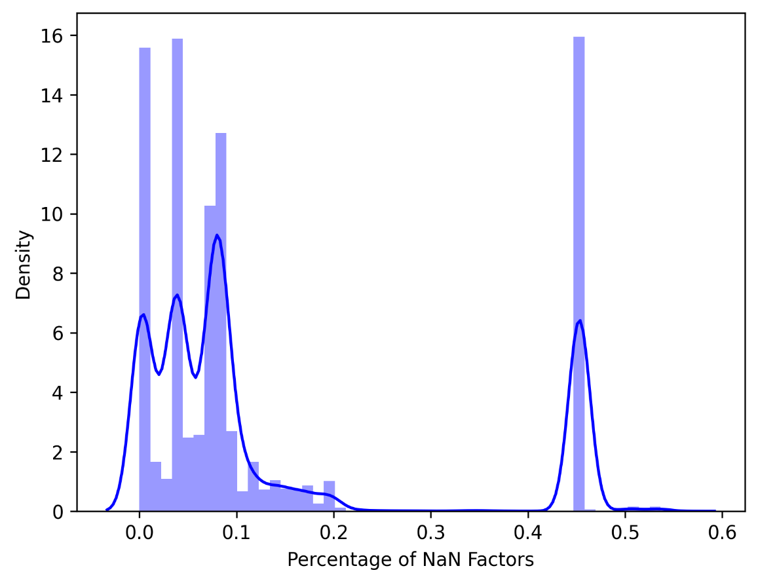
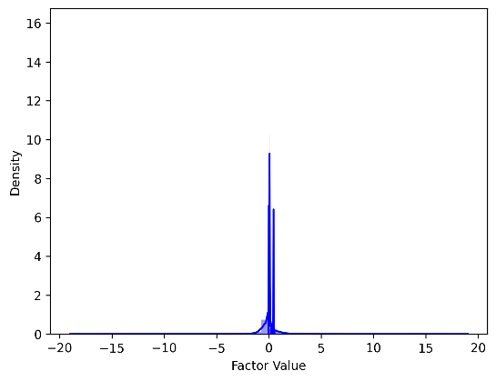
3.1 Select & Normalize
Raw Samples
(500 stocks, 606475 samples)
Samples have
NaN Label
Samples have too many NaN Factors
Slected Samples (Fill NaN by 0)
(360 stocks, 449765 samples)
Cross Sectional
Z-Score Normalization
Normed Samples
Fig 4. The Distribution of Nan Factors Percentage. We dropped samples where the percentage of NaN factors was greater than 10%.
Fig 5. The Select & Normalize Workflow. We also present the normed data distribution here.

Slide 8
3.2 In-Sample & Out-Sample Modeling
Normed
Factors
Daily Return
Label
Normed Samples
Train
Valid
Test
or
Discrete:
0-decrease; 1-no change; 2- increase
MSE Loss
CE Loss
Regression Modeling
Classification Modeling
Return Prediction
Discrete Prediction
All Samples to Train/Valid/Test
➸ In-Sample Modeling
Use Label to
Compute Metrics
Split to Train/Valid/Test
➸ Out-Sample Modeling
F1 Score & ACC
Fig 6. In-Sample and Out-Sample Modeling Framework.

Slide 9
3.2.1 In-Sample ”Perfect” Modeling Method
Normed Samples
Stock 1
Regression Model 1
100%
F1
& ACC
Both regression and classification models have a larger number of parameters than the training sample data.
They are theoretically able to memorize data !
Classification Model 1
Normed Samples
Stock 2
Regression Model 2
Classification Model 2
···
Normed Samples
Stock 360
Regression Model 360
Classification Model 360
Fig 7. Theoretically perfect way of In-Sample modeling.
This doesn‘t make sense for predictions, but is very helpful for checking code (also for grading).
360 overall stocks, 449765 samples: ACC=0.999, F1=0.999

Slide 10
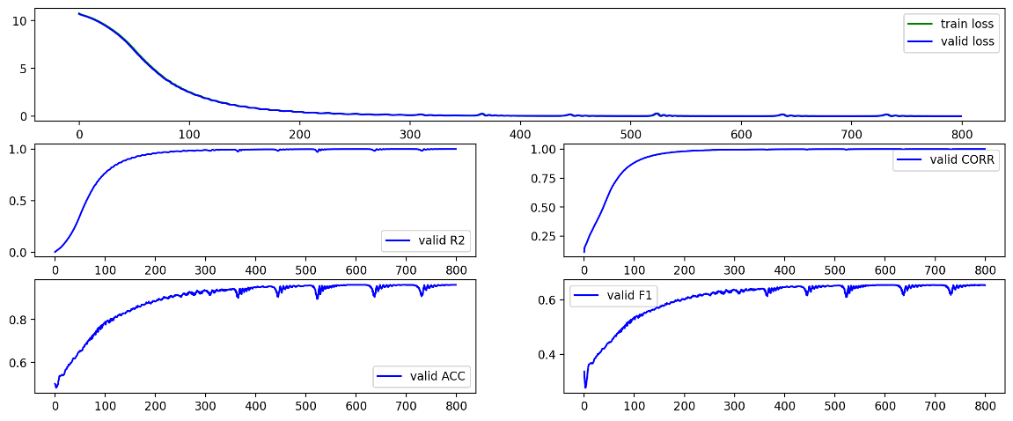
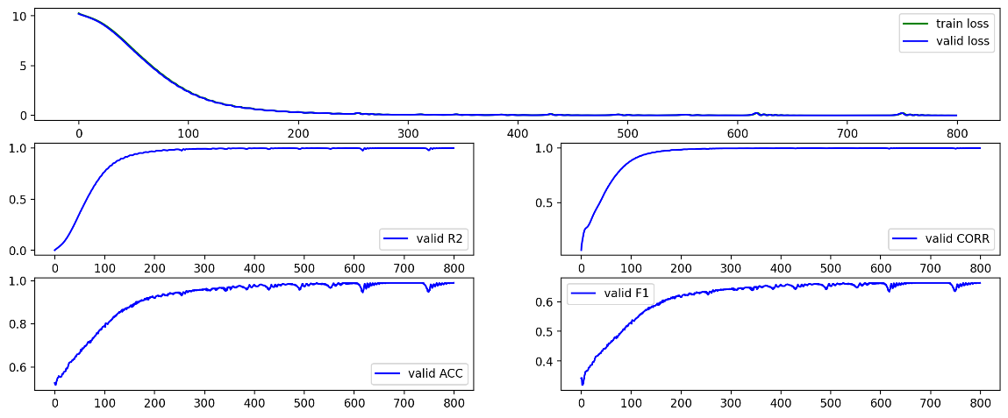
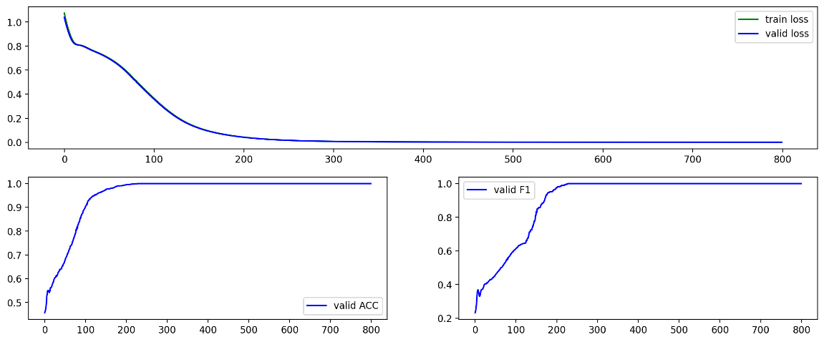
3.2.1 In-Sample ”Perfect” Modeling Result
000009.sz
000021.sz
Regression Modeling: ACC = 0.96, F1 = 0.65
Regression Modeling: ACC = 0.99, F1 = 0.66
Classification Modeling: ACC = 1.00, F1 = 1.00
Classification Modeling: ACC = 1.00, F1 = 1.00
Fig 8. In-Sample Single Stock Modeling Result. We got the theoretically “perfect” result.
Why there is no perfect ACC and F1 when use Regression Modeling ?

Slide 11
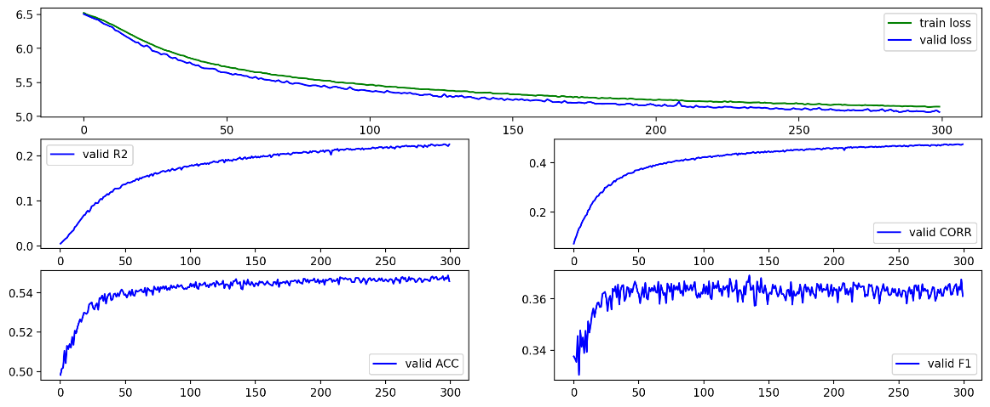
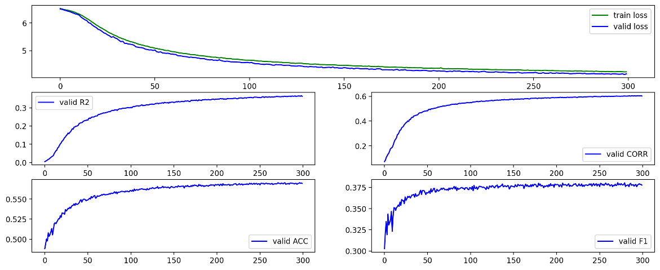
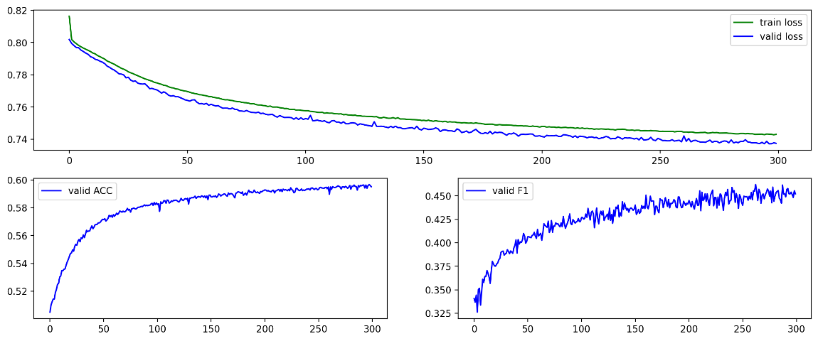
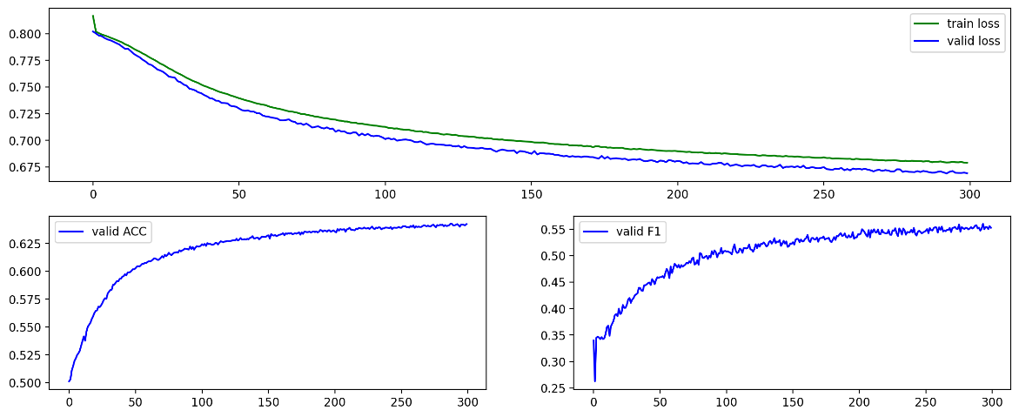
3.2.1 In-Sample Overall Stocks Modeling Result
MLP
Big_MLP
Regression Modeling: ACC = 0.55, F1 = 0.37
Regression Modeling: ACC = 0.57, F1 = 0.38
Classification Modeling: ACC = 0.60, F1 = 0.46
Classification Modeling: ACC = 0.64, F1 =0.56
Fig 9 (a). In-Sample Overall Stocks Modeling Result (MLP and Big_MLP).

Slide 12
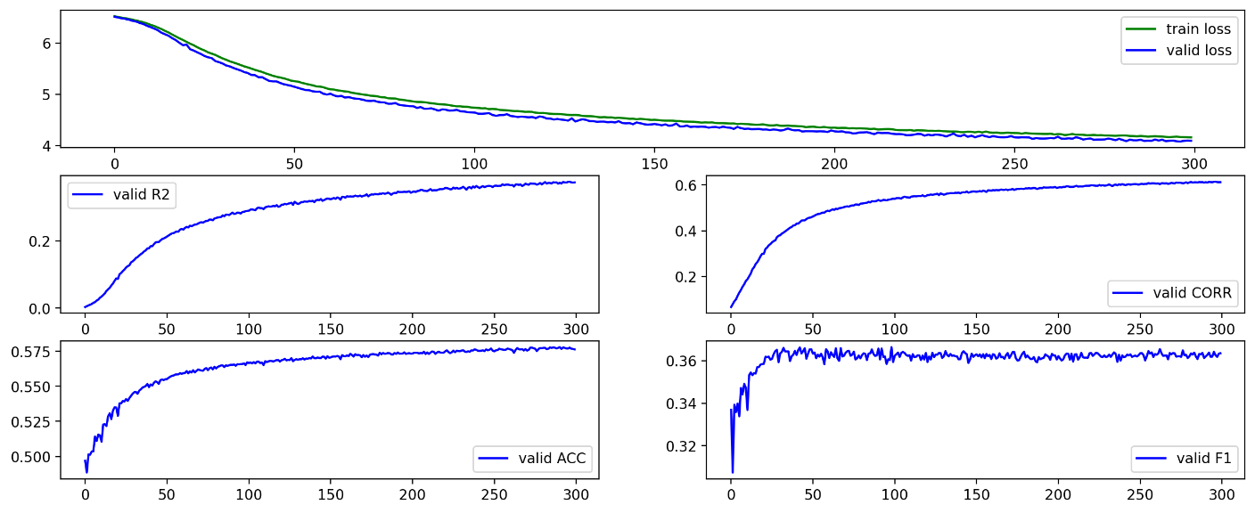
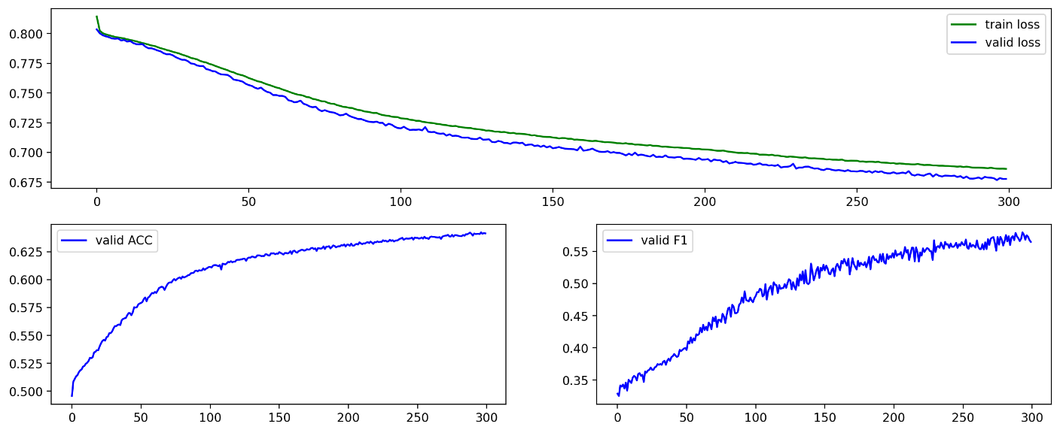
3.2.1 In-Sample Overall Stocks Modeling Result
Conv
Regression Modeling: ACC = 0.57, F1 = 0.37
Classification Modeling: ACC = 0.64, F1 =0.58
Fig 9 (b). In-Sample Overall Stocks Modeling Result (Conv).

Slide 13
3.2.2 Out-Sample ”Perfect” Modeling Method ?
Regression Model 1
Train
Valid
Test
Classification Model 1
100% F1 & ACC ?
Regression Model 2
Train
Valid
Test
Classification Model 2
Both regression and classification models have a larger number of parameters than the training sample data.
···
Regression Model 360
Train
Valid
Test
Classification Model 360
Fig 10. Single Stock Out-Sample Modeling.

Slide 14
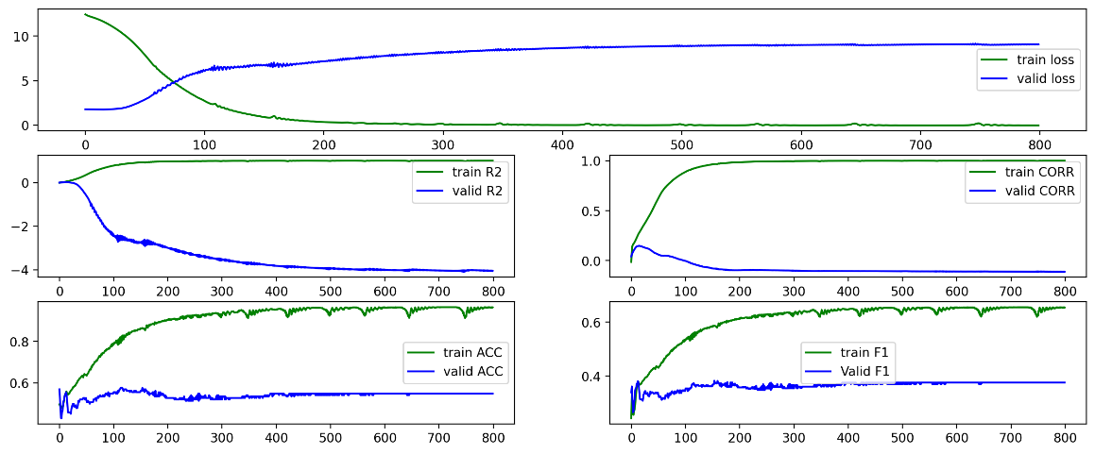
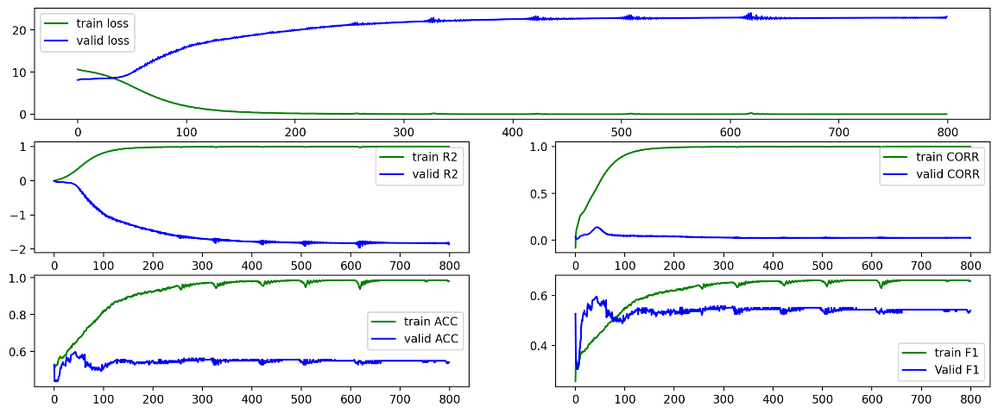
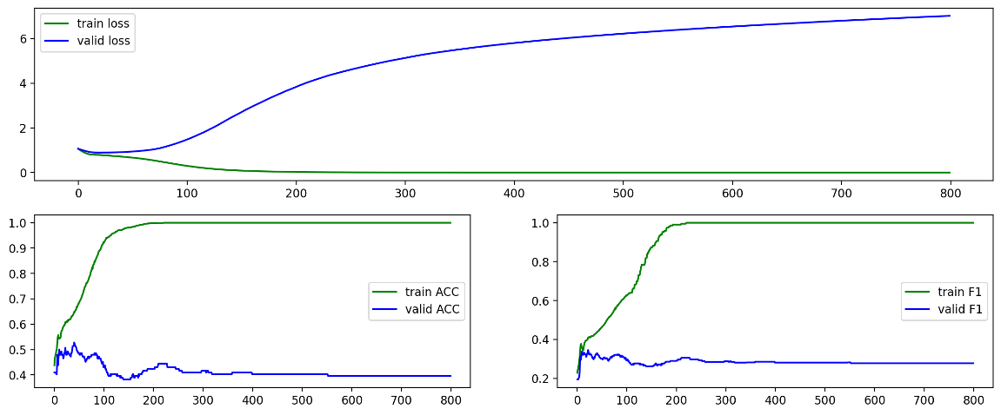
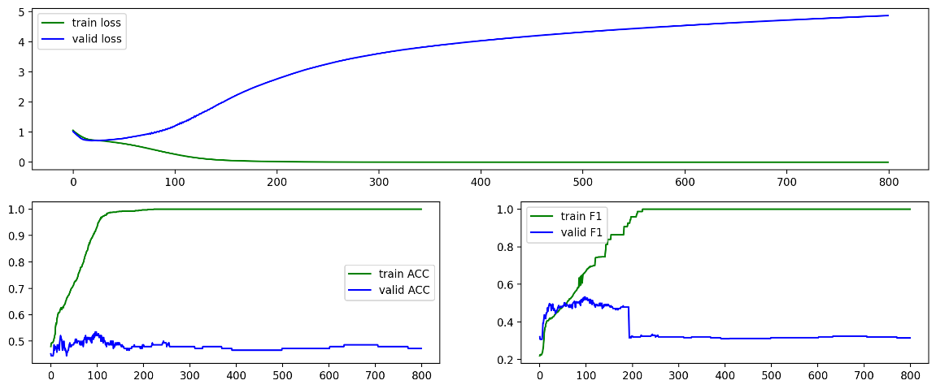
3.2.2 Out-Sample ”Perfect” Modeling Result
000009.sz
000021.sz
Regression Modeling: Test - ACC = 0.44, F1 = 0.29
Regression Modeling: Test - ACC = 0.52, F1 = 0.52
Classification Modeling: Test - ACC = 0.53, F1 = 0.34
Classification Modeling: Test - ACC = 0.48, F1 = 0.46
Fig 11. The Result of Single Stock Out-Sample Modeling.
No perfect ACC and F1 ANYMORE !

Slide 15
3.2.2 Out-Sample Summary Result
Table 1. The Result of Overall Stock Out-Sample Modeling.

Slide 16
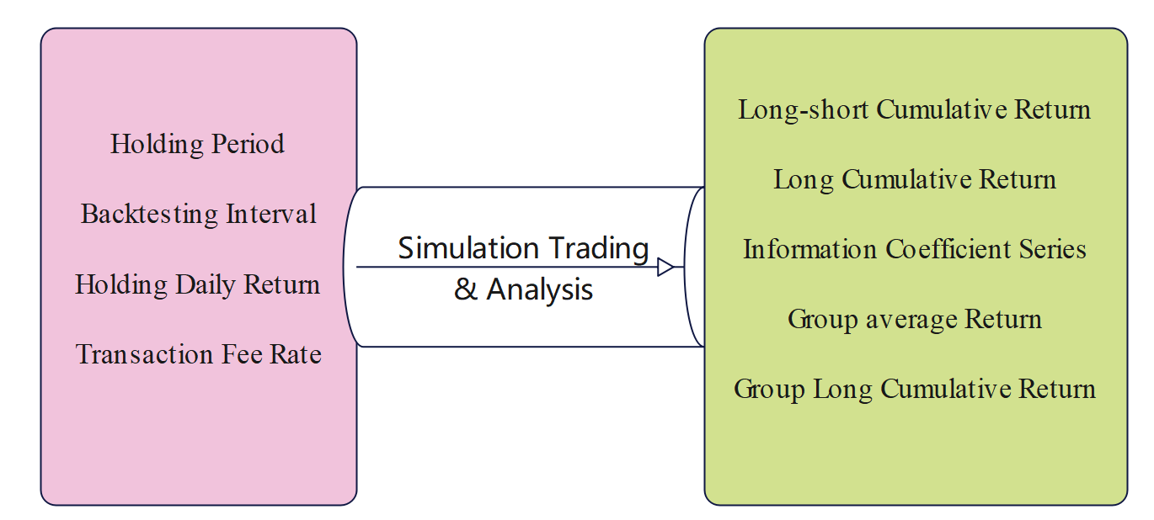
3.3 Out-Sample Backtesting
Daily:
Long 50% largest
Short 50% smallest
PV weighted
Prediction Value(PV)
Trading Strategy
Backtesing Parameters
Backtesing Results

Slide 17
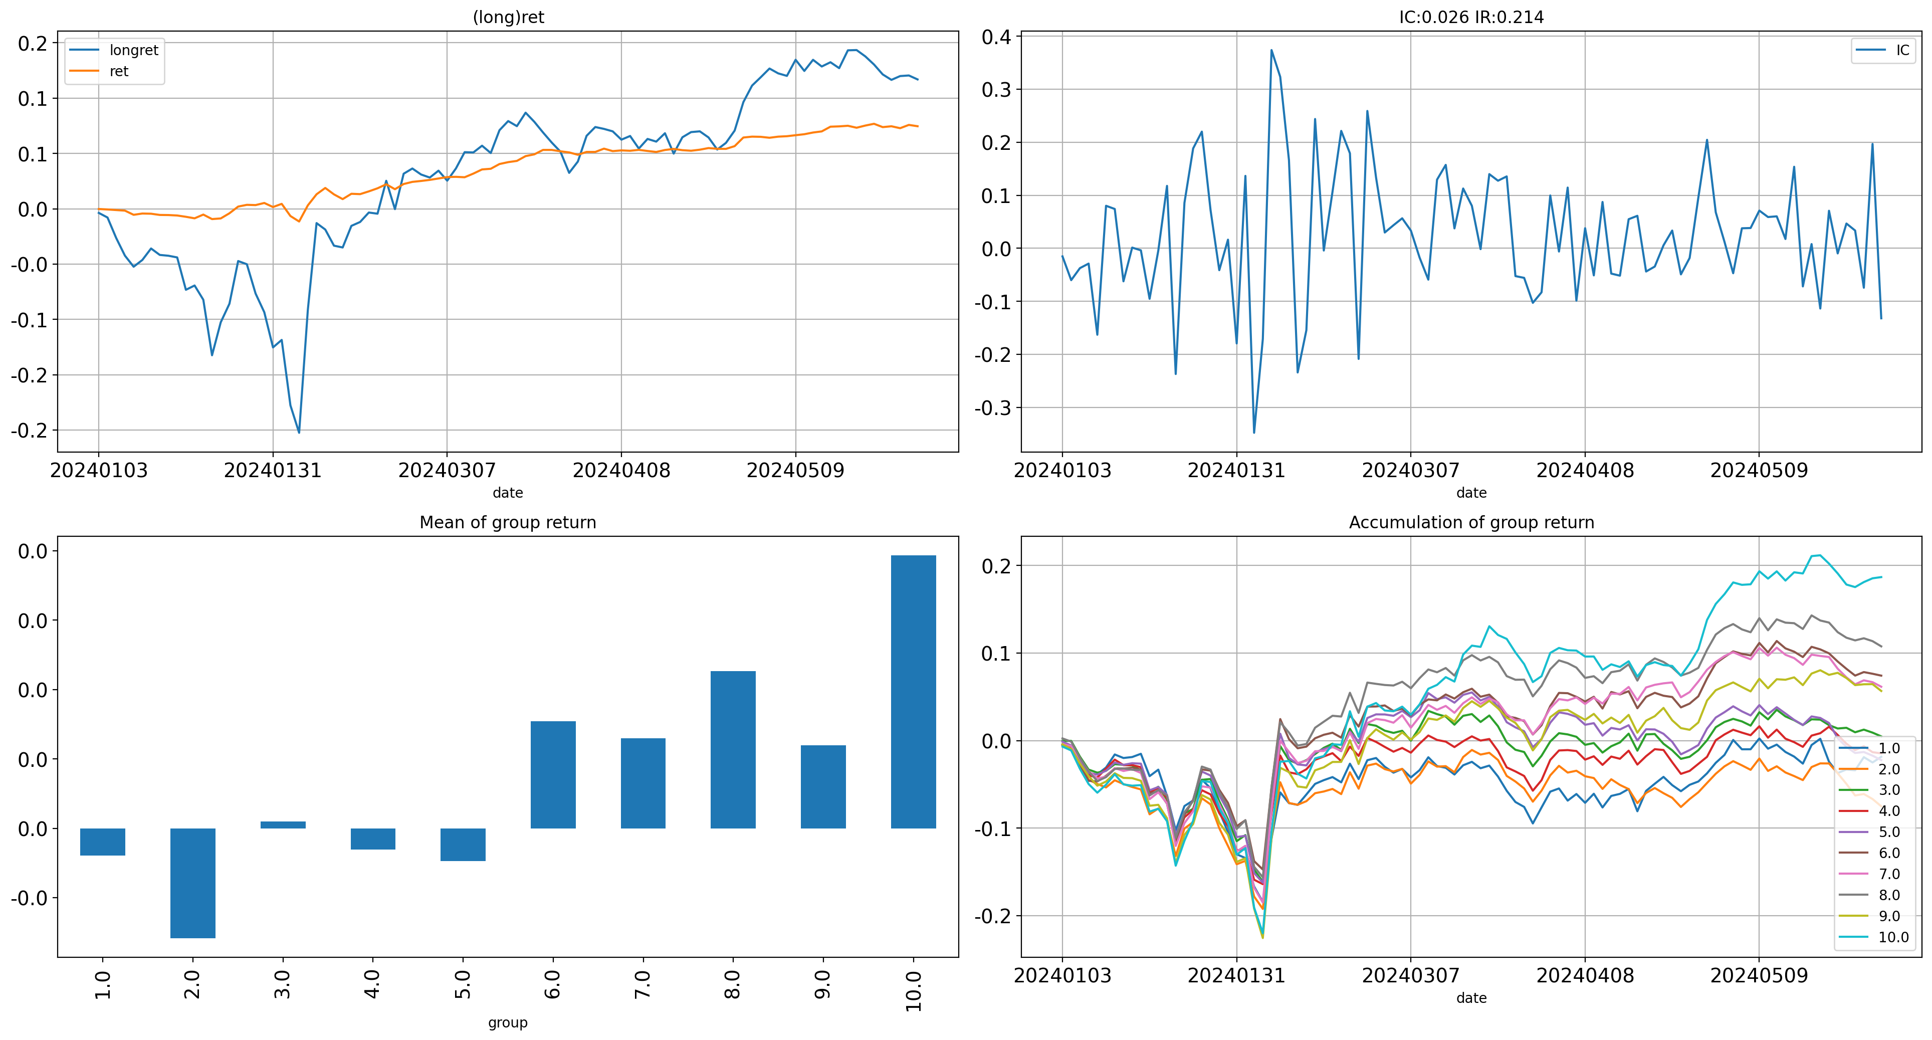
3.3 Out-Sample Backtesting
Fig 12. The Result of Out-Sample Backtesting.
return | win_rate | sharpe | turnover | drawdown | dd_sdate | dd_edate
0.07 | 0.59 | 3.80 | 0.90 | 0.02 | 20240130 | 20240205

Slide 18
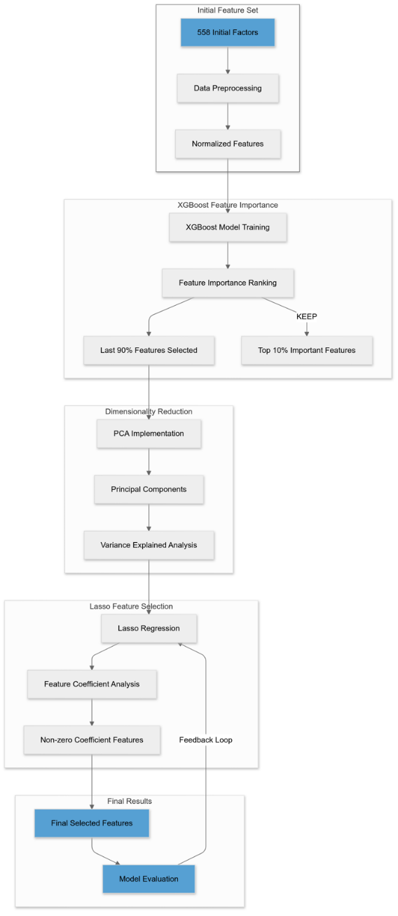
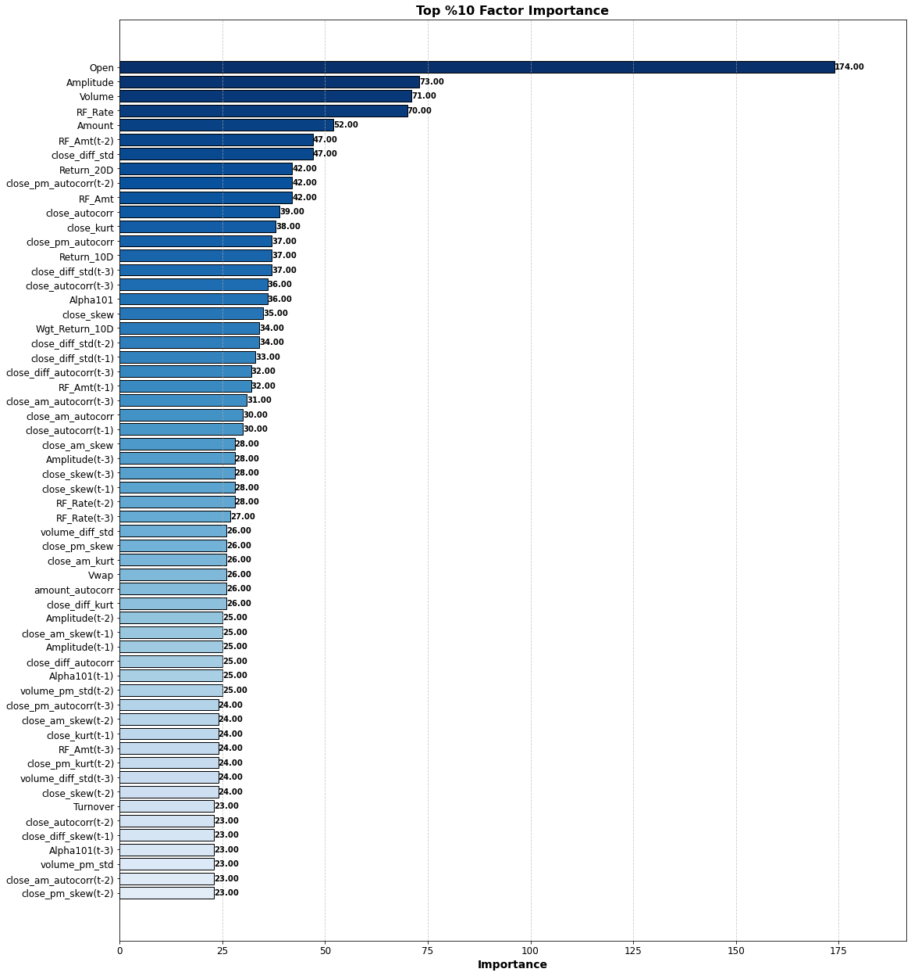
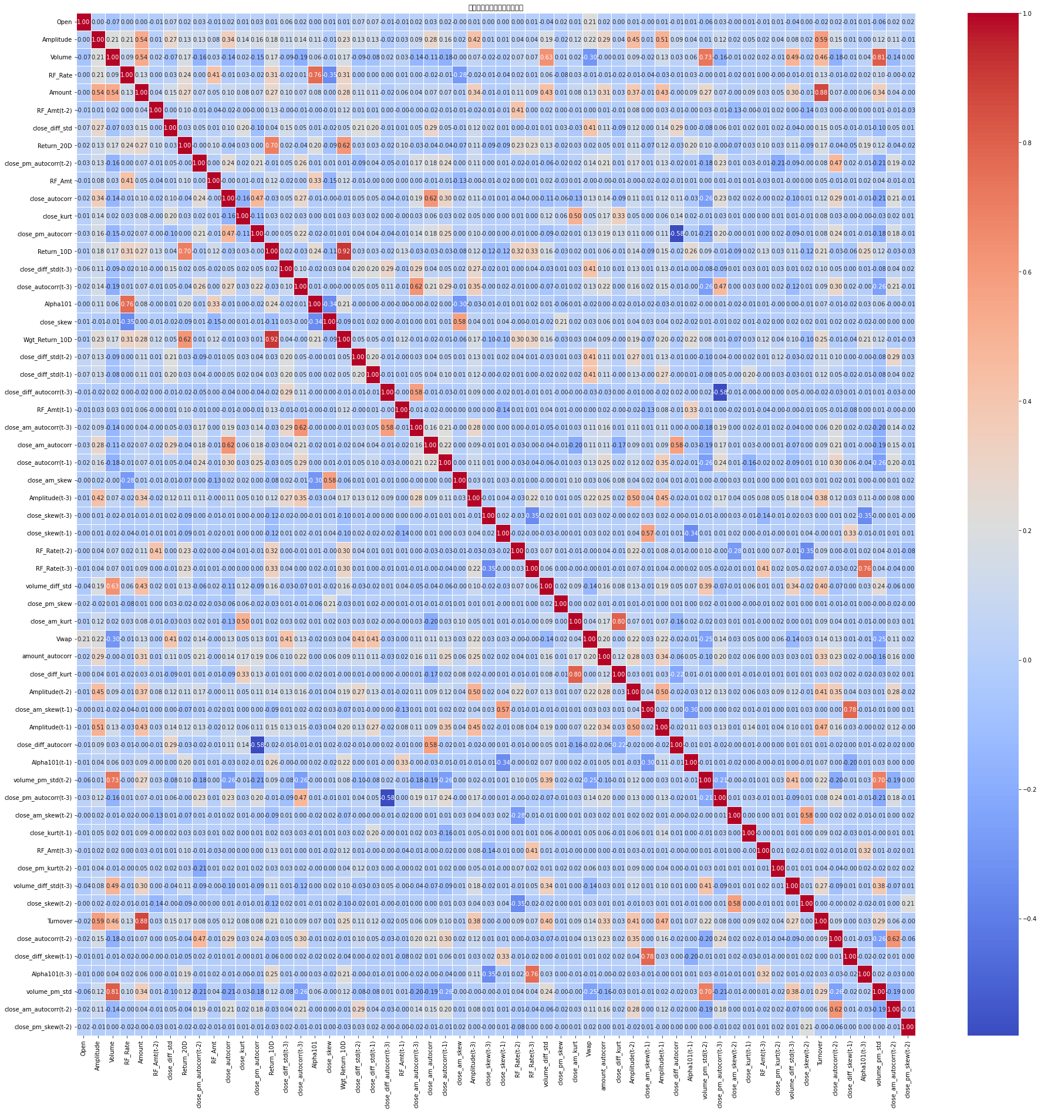
4.1 Which factors matter?
Purpose：To evaluate factors and figure out their contribution to the final result
Generate Feature Importance for 558 Factors
& Select top 10% important factors
by XGBoost
Fig 13. Flowchart for Feature Importance
Fig 14. Top10% Feature Importance
Fig 15. Top10% Feature Correlation
Notes:
后续子标题改好

Slide 19
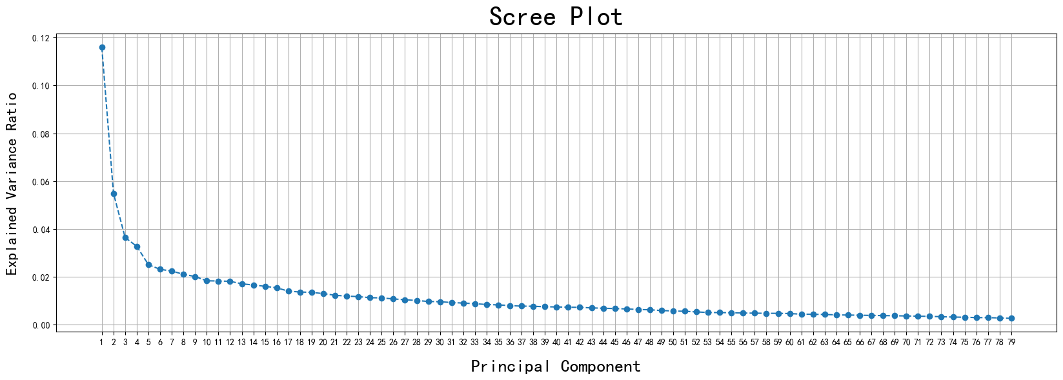
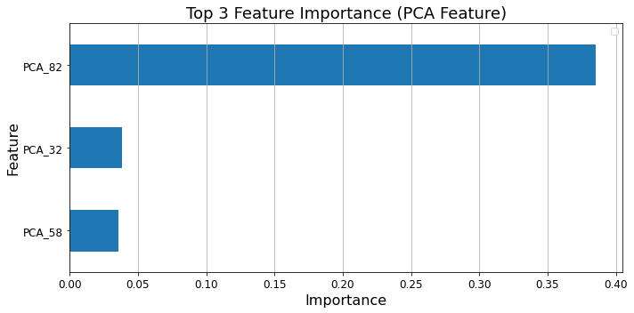
4.1 Which factors matter?
2. Dimensionality Reduction via PCA (Rest “eliminated” Factors)
500 Factors => 79 Principle Components
Fig 17. Scree Plot for PCA
3. Evaluation of New Factors Using Lasso Regression
by driving less significant coefficients to zero
79 Principle Components => 3 Components
Fig 16. Flowchart for Feature Importance
Fig 18. Top 3 Importance by Lasso

Slide 20
4.2 Result Analysis
1. Top 10% Factors all belong to daily trading factors, high frequency factors and their related lagged data.
More sensitive to immediate market conditions.
Capture short-term price movements, volatility, and liquidity
Reflect the latest market behaviors, making them more relevant for immediate decision-making.
Fig 19. Top 10% Factor Importance

Slide 21
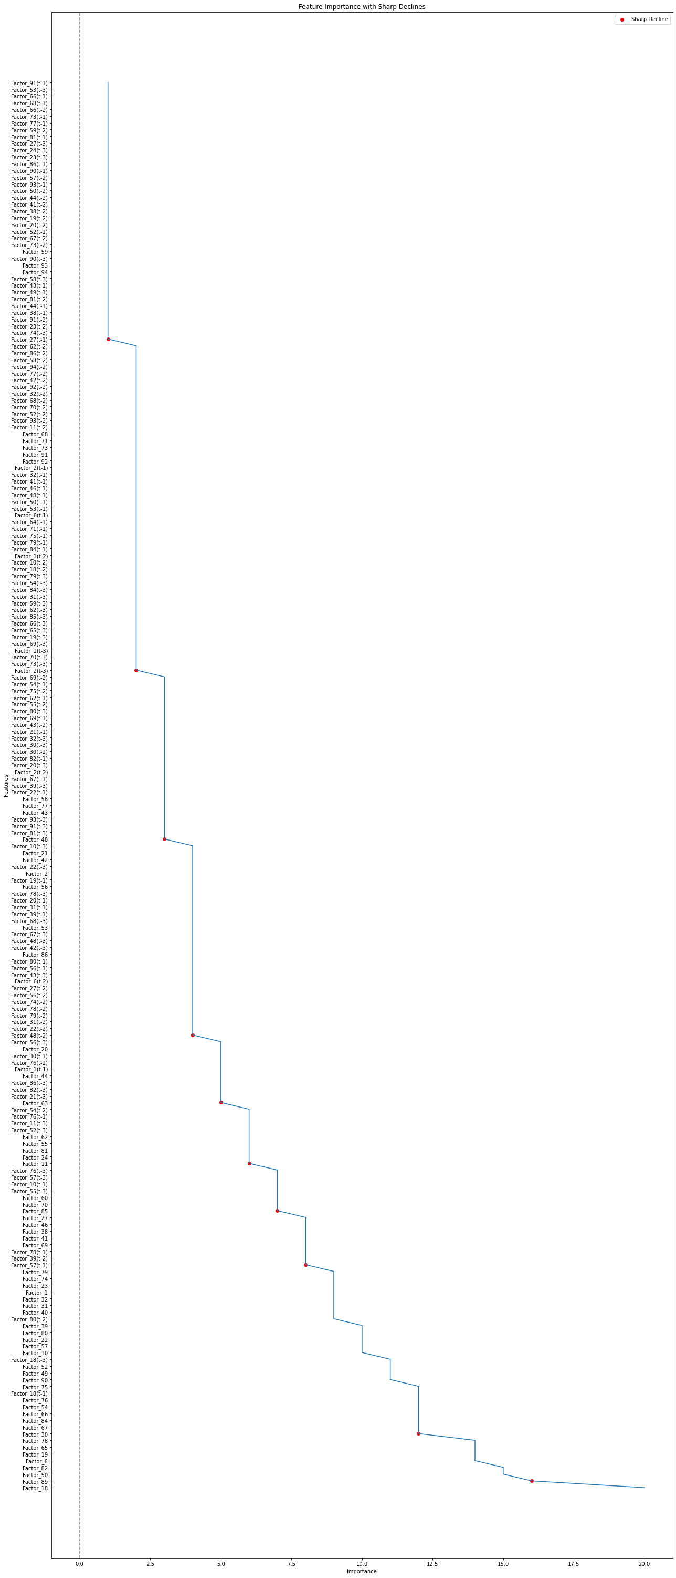
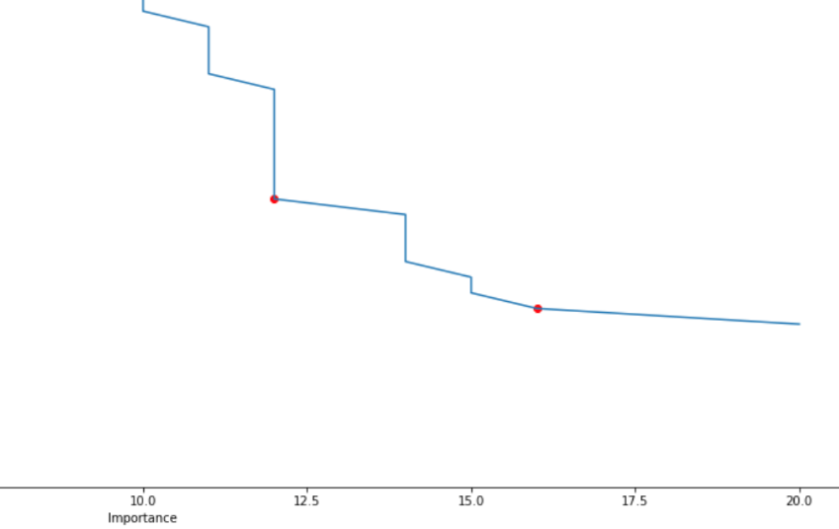
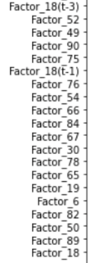
4.2 Result Analysis
Fundamental Factors
1. Factor_18 (𝑐ℎ𝑚𝑜𝑚) rank 1st, Factor_89 (𝑙𝑎𝑟𝑔𝑒𝑠𝑡ℎ𝑜𝑙𝑑𝑒𝑟𝑟𝑎𝑡𝑒) rank 2nd
𝑐ℎ𝑚𝑜𝑚, a momentum indicator that captures the tendency of assets with strong past performance to continue outperforming. ---Monthly
𝑙𝑎𝑟𝑔𝑒𝑠𝑡ℎ𝑜𝑙𝑑𝑒𝑟𝑟𝑎𝑡𝑒, the largest holder rate reflects the proportion of shares owned by the largest shareholders. ---Quarterly
2.A sharp decline (>20%) in importance between them.
𝑐ℎ𝑚𝑜𝑚 captures a broader trend of momentum that might overshadow specific ownership insights provided by 𝑙𝑎𝑟𝑔𝑒𝑠𝑡ℎ𝑜𝑙𝑑𝑒𝑟𝑟𝑎𝑡𝑒.
The relationship between ownership concentration and stock performance may be partly mediated by momentum, making it less independently valuable.
Fig 20. Fundamental Feature Importance Change

Slide 22
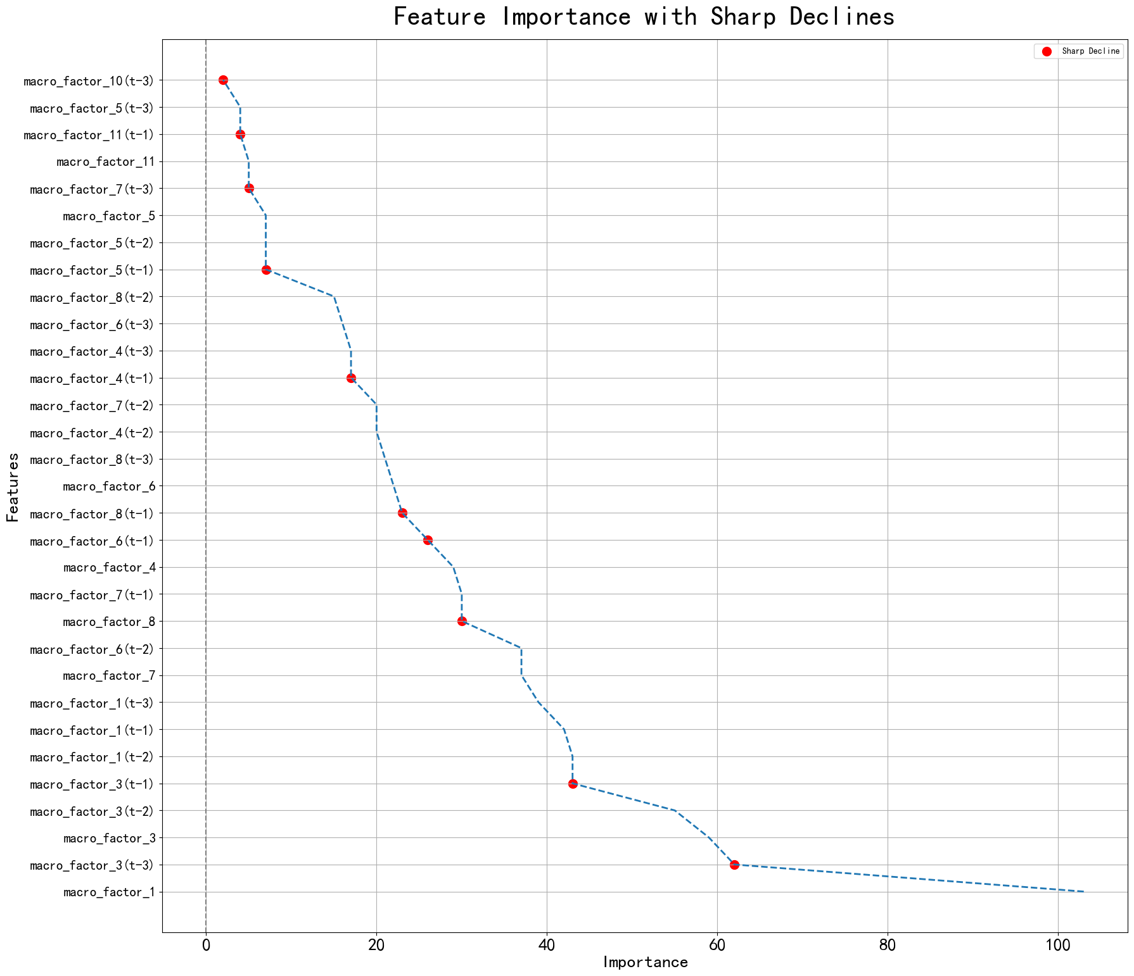
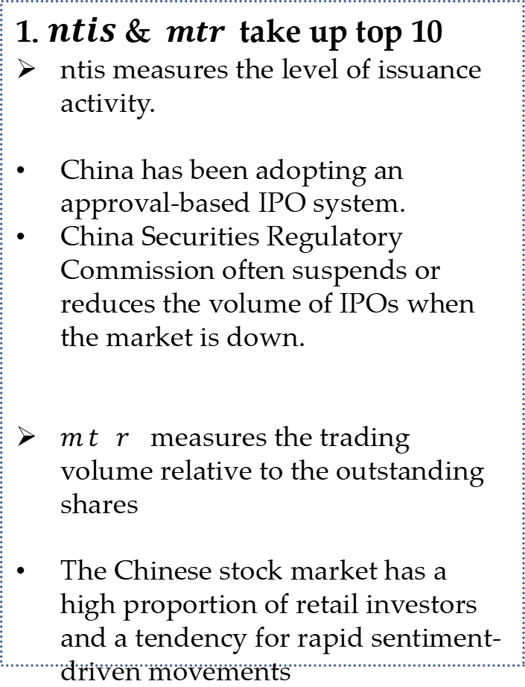
4.2 Result Analysis
Macroeconomic Factors
1. $ntis$ & $mtr$ take up top 10
ntis measures the level of issuance activity.
China has been adopting an approval-based IPO system.
China Securities Regulatory Commission often suspends or reduces the volume of IPOs when the market is down.
𝑚𝑡𝑟 measures the trading volume relative to the outstanding shares
The Chinese stock market has a high proportion of retail investors and a tendency for rapid sentiment-driven movements
Fig 21. Macroeconomic Feature Importance Change

Slide 23
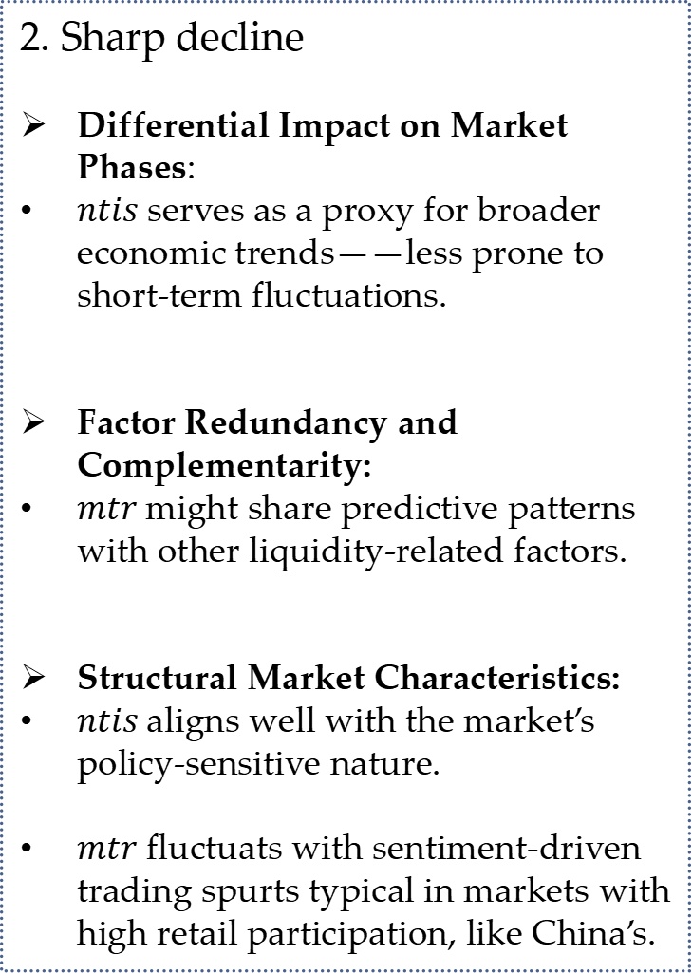
4.2 Result Analysis
Macroeconomic Factors
2. Sharp decline
Differential Impact on Market Phases:
$ntis$ serves as a proxy for broader economic trends——less prone to short-term fluctuations.
Factor Redundancy and Complementarity:
$mtr$might share predictive patterns with other liquidity-related factors.
Structural Market Characteristics:
$ntis$aligns well with the market’s policy-sensitive nature.
$mtr$ fluctuats with sentiment-driven trading spurts typical in markets with high retail participation, like China’s.
Fig 22. Macroeconomic Feature Importance Change

Slide 24
Data Analysis Project 2.
Predicting Stock Returns Using Text data
Nov 4, 2024
Group Members: Kai Ren, WeiJie Zhang, Yang Lan, YiMing Jiang, Rui Hu

Slide 25
Data Analysis Project 2 Framework
Crawling Data from Website
Collecting Dataset
Embedding
Training Model
Reduce Dimension
87429 pieces of related data
(87429, 768)
(87429, < 768)
Reduce Dimension
Machine Learning Models 🔥
MLP
LSTM
···
Conv
Fig 1. The Framework of Data Analysis Project 2.

Slide 26
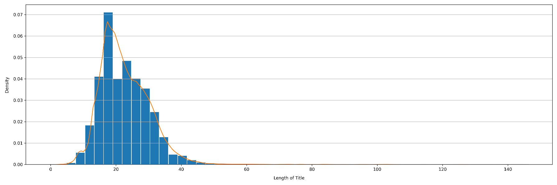
1. Data Collection
Research object：Stocks listed on the Shanghai and Shenzhen stock markets in early October
Time interval：January 1st, 2019 – June 30th, 2024 (5.5 years with 1312 trading days)
Data：Title of individual stock research report from Oriental Wealth Network Data Center
87429 pieces of data, with an average length of 22.67
Shortest title length is 2： report on Zhongfu Industry (600595.sh) released by Zhongtai Securities, January 9, 2024
Longest title length is 144：Earnings Review: Mixed FY19/1Q20: Expect domestic revenue to recover, expense ratio to stabilize; exposure to overseas retail market a risk; Buy, report on Haier Smart Home (600690.sh) released by Goldman Sachs Gao Hua Securities, May 8, 2020
Fig 2. Distribution of Title Length in Individual Stock Research Reports.

Slide 27
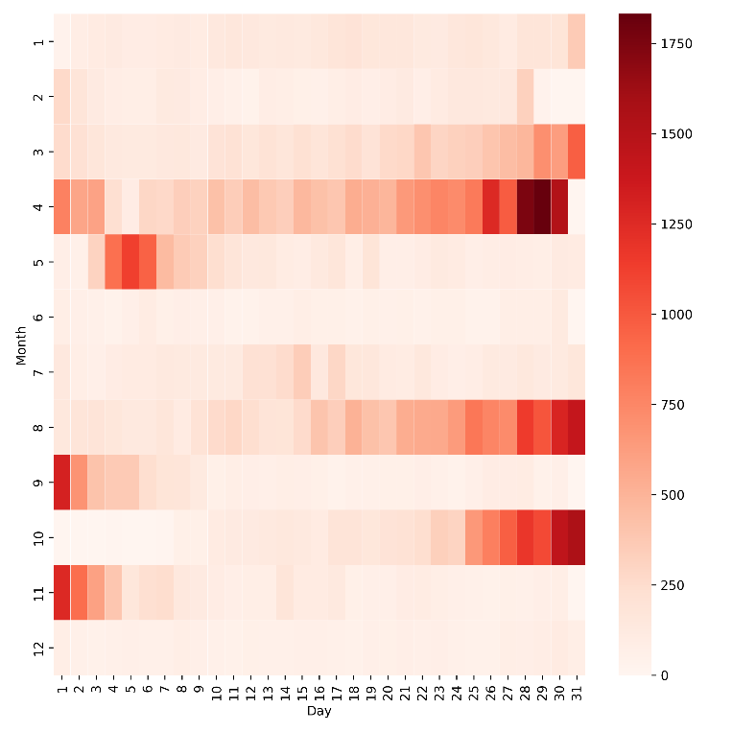
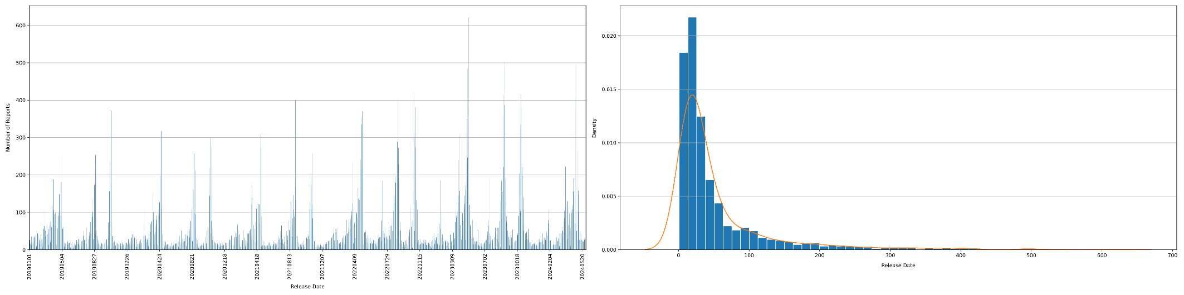
1.1 Data Description on Time Dimension
Out of 2007 days, at least 1report was released in 1711 days
Average daily report publication: 51.10 articles
In 34 days, There was only 1 article published
Maximum publication of 622 articles, May 4, 2023
Periodicity on publishment: 3 peaks
Late April
Late August to early September
Late October to early November
Fig 3. Heat map, bar chart, and distribution of the number of daily stock reports published.

Slide 28
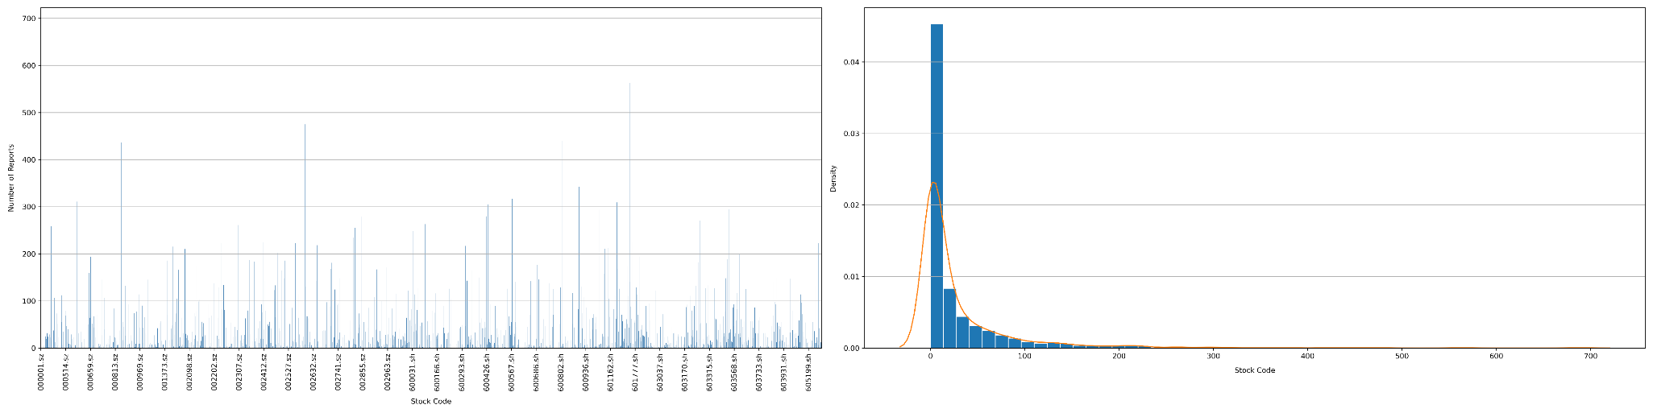
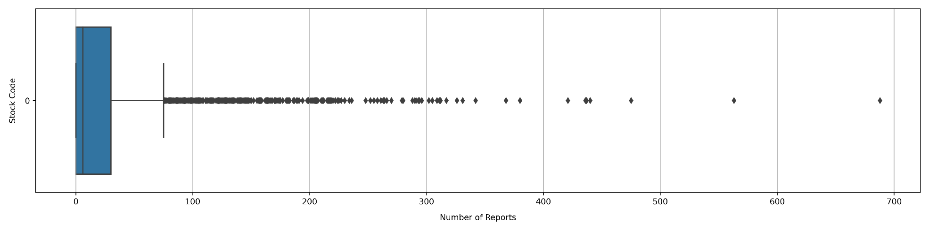
1.2 Data Description on Stock Dimension
Out of 3153 stocks, only 2392 stocks have at least one research report data
Average reports per stock: 27.73 articles, median 6 articles
Stock with the most reports: 688 articles, Kweichow Moutai (600519.sh)
Fig 4. Bar chart, distribution and boxplot of the number of reports published per stock.

Slide 29
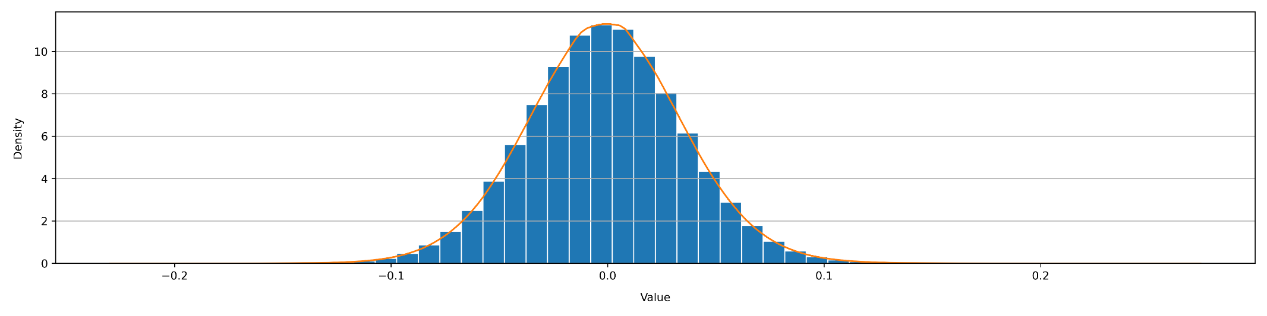
2. Data Processing and Text Embedding
Labels: 5m-frequency data to calculate the vwap 10 minutes after the opening (09:30-09:40)
The labels of returns with different maturities will be used to measure the predictive performance of the model on short-term and long-term returns.
$$Label_{1}=\frac{vwap_{t+1}−vwap_{t}}{vwap_{t}}$$
$$Label_{3}=\frac{vwap_{t+3}−vwap_{t}}{vwap_{t}}$$
$$Label_{10}=\frac{vwap_{t+10}−vwap_{t}}{vwap_{t}}$$
report title
(87429, 1)
text-embedding-3-small
data for modeling
(87429, 768)
Fig 5. Model input and output in text embedding.
Fig 6. Distribution of data obtained after text embedding, with maximum value 0.2710, minimum value -0.2268, mean value -0.0012, standard deviation 0.0361.

Slide 30
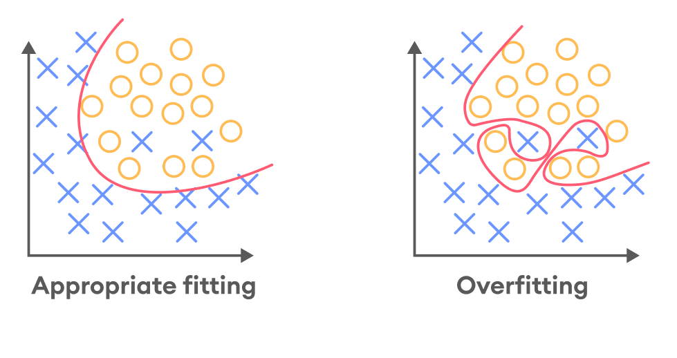
3.1 Purpose of Dimension Reduction
Embedding Layer
2. High-dimensional embeddings capture intricate details and nuances of the textual data
···
768D
···
···
···
···
···
···
···
···
1. Abundant information may cause overfitting
Purpose
To increase the signal-to-noise ratio
To extract economically meaningful insights
To preventing overfitting

Slide 31
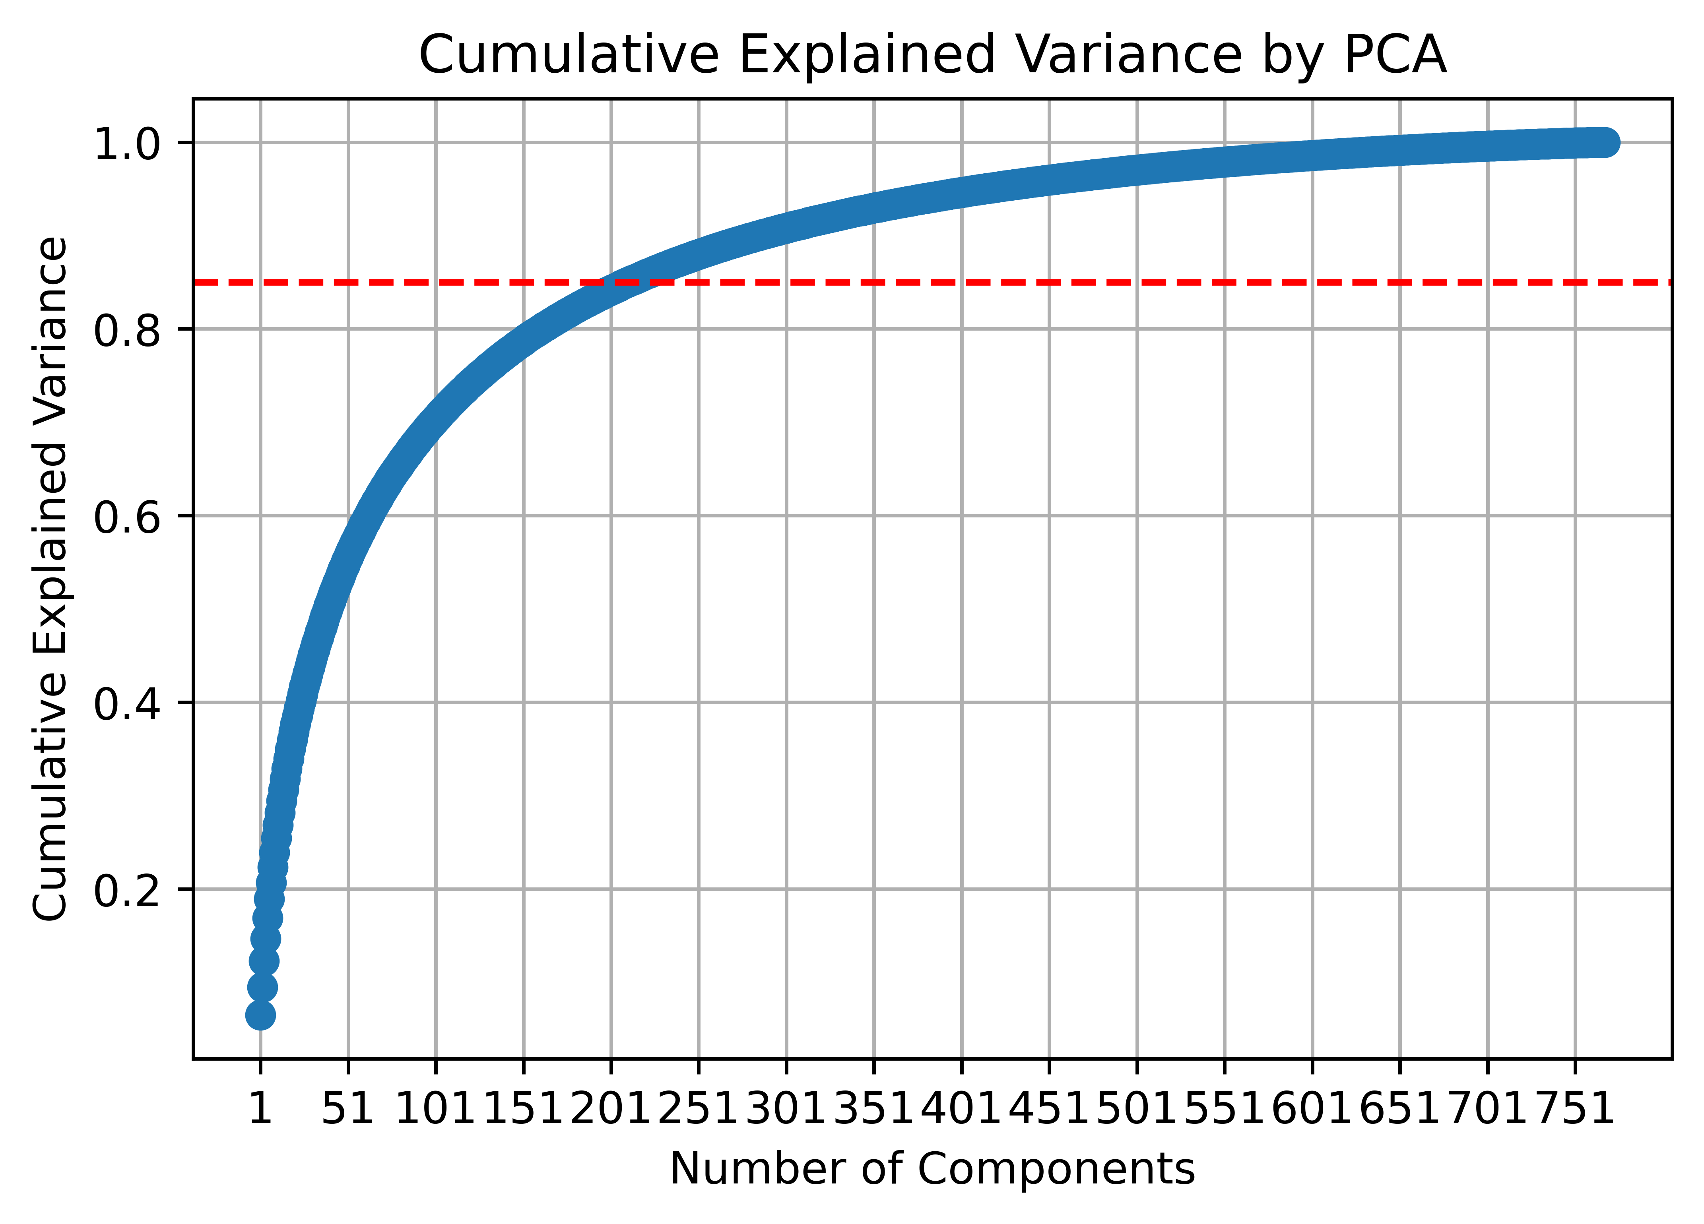
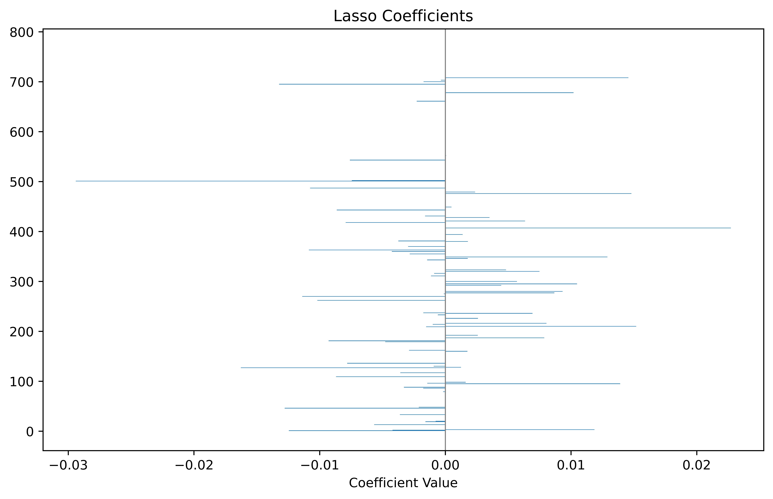
3.2 Process & Result of Dimension Reduction
Embedding Data with Label
Train-Test Split
Fig 7. Cumulative Explained Variance by PCA
Dimension Reduction
PCA
Lasso
XGBoost
211D
77D
230D
Fig 8. Coefficients for Lasso selection

Slide 32
4. Modeling Result
Tabel 1. Modeling Result

Slide 33
Future Explorations
Dataset:
Try to build up MORE factors.
MORE text data (more sources, more kinds)
Modeling:
Try to build up MORE kinds of models.
Select and put different factors.
Back testing:
More complex strategies.

Slide 34
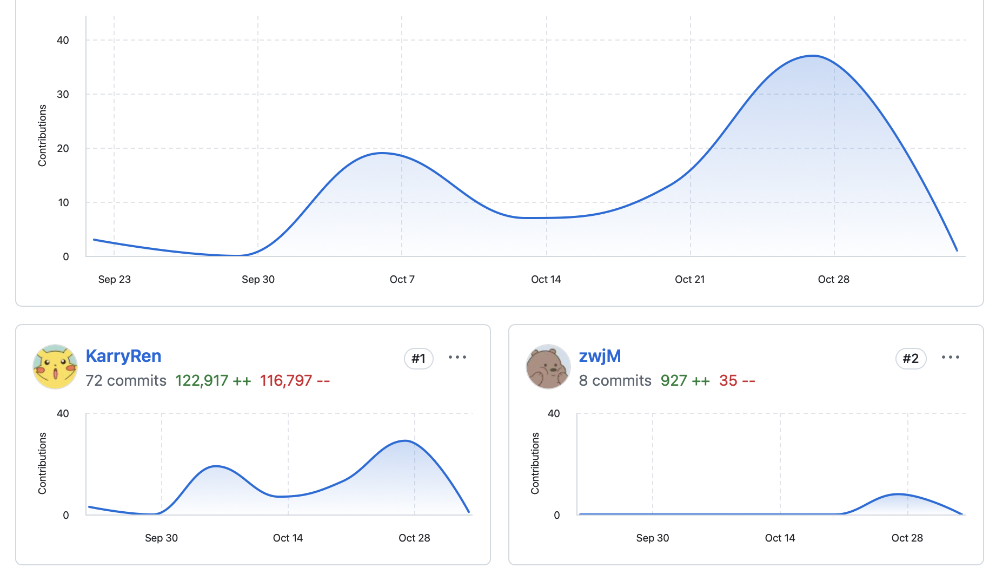
Our contribution
We have constructed a framework for the collection processing and analysis of structured as well as textual factorized data.
A well-constructed database of structured factors was built, as well as a text database.
We explored the effects of modeling with different DL models.
We open-sourced all the code, in which the modeling part is built using the Pytorch framework, which is highly extensible. (7000+lines) https://github.com/KarryRen/Introduction-to-Fintech-DAPs

Slide 35
Thank You
Nov 4, 2024
Group Members: Kai Ren, WeiJie Zhang, Yang Lan, YiMing Jiang, Rui Hu

